Slide 1
The Design of Java

Slide 2
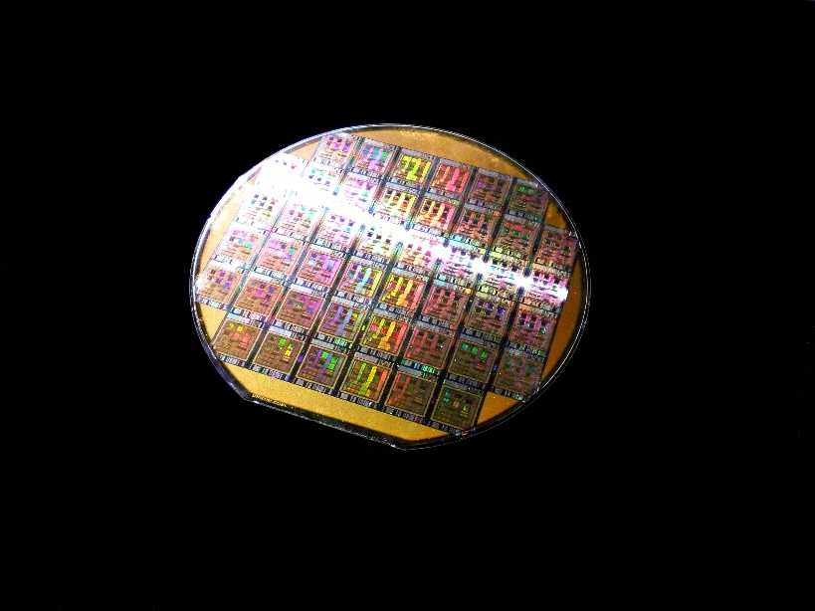
The Score Processor
A real-world example.

Slide 3
Score Processor
Used in embedded high-consequence systems.
Processor is radiation hardened.
Supports a subset of Java bytecodes (around 144)

Slide 4
Project included
Implementation of reduced instruction set of the JVM in SML.
TL System
Implementation of a static classloader
Source-code migrator (i.e., analysis and manipulation system)

Slide 5
Source-Code Migrator Goal and Issues
Remove at the source code level, all program elements that depend directly or indirectly on unsupported bytecodes (i.e., the reflexive-transitive closure of dependencies on unsupported bytecodes).
Shadowing, Overwriting, Overloading
Dynamic downloading of classes prohibited
Dependency analysis on closed versus open code bases.
How many classes belong to the closed code base for a simple “hello world” program?

Slide 6

Java started out as a relatively clean language
Notes:
Java star

Slide 7
Referential Transparency
The idea that things that are equal can be substituted for one another

Slide 8
class B {
byte b = 1;
int x1 = f(b);
int x2 = f(1);
int x3 = f(b + b);
int f(byte b) { return 1; }
int f(int i) { return 10; }
}
x1 = 1
x2 = 10
x3 = 10

Slide 9
class D {
char c = 'c';
byte b1 = 'c';
byte b2 = c;
byte b3 = 1;
byte b4 = 1 + b3;
byte b5 = 1 + 1;
}
b2 → compile-time error
b4 → compile-time error

Slide 10
Uniformity
Similar looking things should behave similarly

Slide 11
class B {
boolean eq(Integer x, Integer y) { return x == y; }
boolean flag1 = eq(100,100);
boolean flag2 = eq(200,200);
}
flag1 = true
flag2 = false

Slide 12
package p1;
import p2.B;
public class A {
String f() { return "p1.A.f"; }
public static void main(String[] args){
A myB = new B();
A myC = new C();
System.out.println("myB.f() = " + myB.f());
System.out.println("myC.f() = " + myC.f());
}
}
class C extends A {
String f() { return "p1.C.f"; }
}
package p2;
public class B extends p1.A {
String f() { return "p2.B.f"; }
}
myB.f() = p1.A.f
myC.f() = p1.C.f

Slide 13
package p1;
public class D {
int x1 = 1;
}
class C extends D {
int x2 = x1 + 1;
}
class E {
class C extends D {
int x2 = x1 + 1;
}
class D {
private int x1 = 1;
}
}
package p2;
public class F extends p1.D {
int x2 = x1 + 1;
}
In p1.C, x1 is visible
In p1.E.C, x1 is not visible
In p2.F, x1 is not visible

Slide 14
public class A {
class B {
class B1 {
private class C1 {}
}
private class C2 {}
}
class innerA1 extends B {
B1.C1 x1;
C2 x2;
}
}
In innerA1, B1.C1 is visible
In innerA1, C2 is not visible
Notes:
B1 is visible through inheritance
C1 is visible through the qualified path B1.C1 – because inner classes are involved, private elements are visible.
The private elements of B are not visible through inheritance (even when inner classes are involved).

Slide 15
Simplicity
To effectively use a language construct you must understand it.

Slide 16
package p1;
import p2.B;
public class A extends B {
C1 myC1_1;
B.C1 myC1_2;
p2.B.C1 myC1_3;
p2.C.C1 myC1_4;
C1.C2 myC2;
C1.C3 myC3;
B myB;
int x1 = myB.static_c;
int x2 = myB.c;
int x3 = c;
}
package p2;
public class B extends C {}
class C {
protected class C1 {
protected class C2 {}
public class C3 {}
}
protected static int static_c;
protected int c;
}
p2.C.C1 is not visible
C1.C2 is not visible
myB.c is not visible
Notes:
The prefix p2.C is not visible
C1.C2 - C1 is visible through inheritance, but C1.C2 is not inherited by A
Inheritance path of non-static fields must go through A to get to B (see assignment to x3, also note that the simple id static_c is visible.)
The inheritance path of static fields go through types (i.e., classes rather than objects).

Slide 17
package p1;
import p3.C; import p3.D; import p3.E;
public class A extends p2.B {
public class nestedA {
C c; D d; E e;
int x1 = c.Bi;
int x2 = d.c.Bi;
int x3 = e.Bi;
int x4 = c.e.Bi;
}
}
package p2;
public class B { protected int Bi; }
package p3;
public class C extends p1.A { public E e; }
public class D { public C c; }
public class E extends p2.B {}
c.Bi is visible
d.c.Bi is visible
e.Bi is not visible
c.e.Bi is not visible
Notes:
The inheritance path must pass through A in order to be visible.

Slide 18
class C<T> {
class T {
T T;
}
}
Field T is of type <T>
Type erasure is performed in an outside-in manner.
Name resolution is performed in an inside-out manner.

Slide 19
package p1;
import static p2.B.X;
// imports both a field and a type.
public class A {
int x = X;
X myX;
}
class A1 extends X {}
package p2;
public class B {
public static int X;
public static class X {}
}
Eclipse Helios (build id: 20100617-1415) fails to resolve X

Slide 20
package stackoverflow;
import static stackoverflow.A00.*;
public class A00 extends B00 {
public static class B00 {}
}
Causes a stack overflow when compiled using the Java 1.6.0_26 compiler

Slide 21

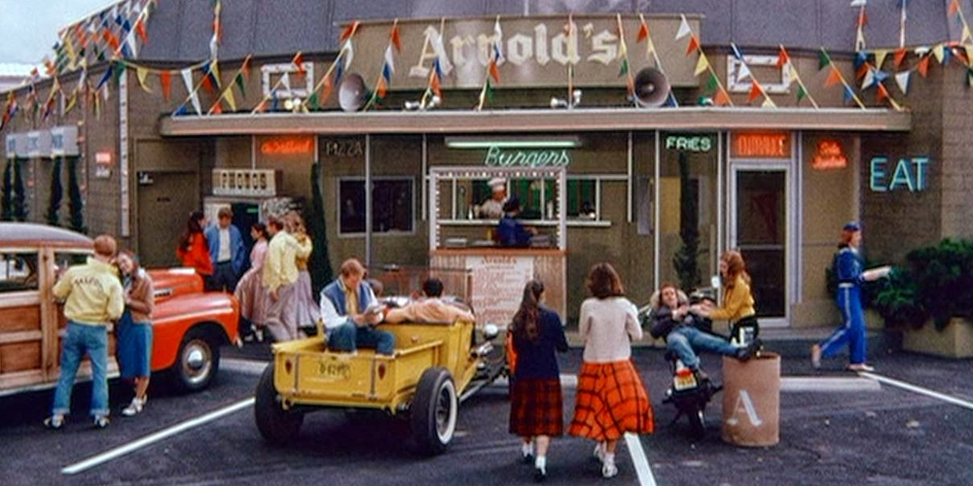
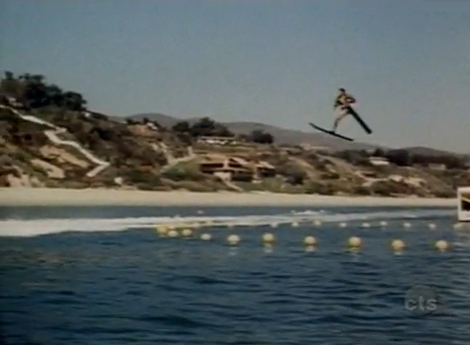

Slide 22
CMU 2011
Object-oriented programming is eliminated entirely from the introductory curriculum, because it is both anti-modular and anti-parallel by its very nature, and hence unsuitable for a modern CS curriculum.

Slide 23
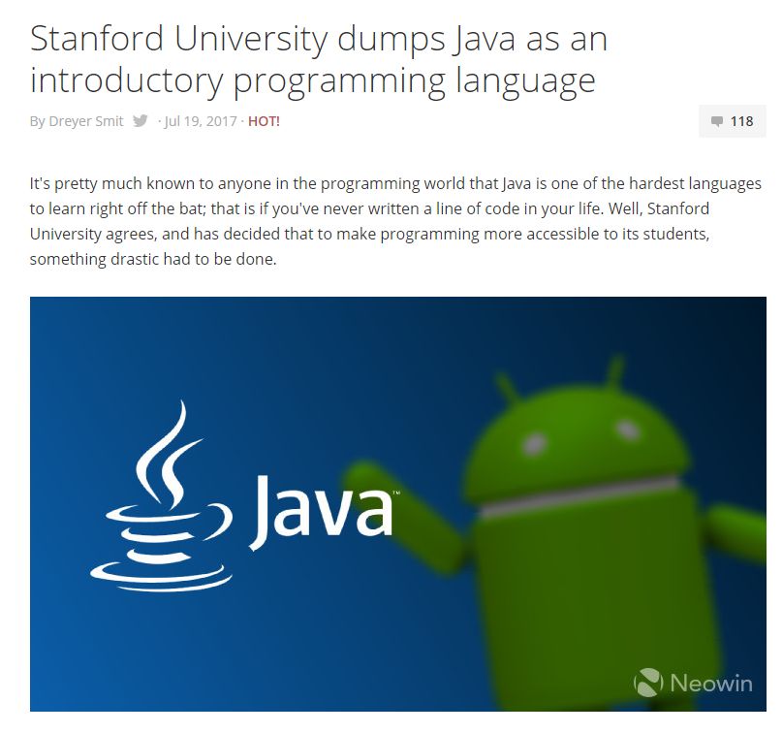

Slide 24
The End

